Slide 1

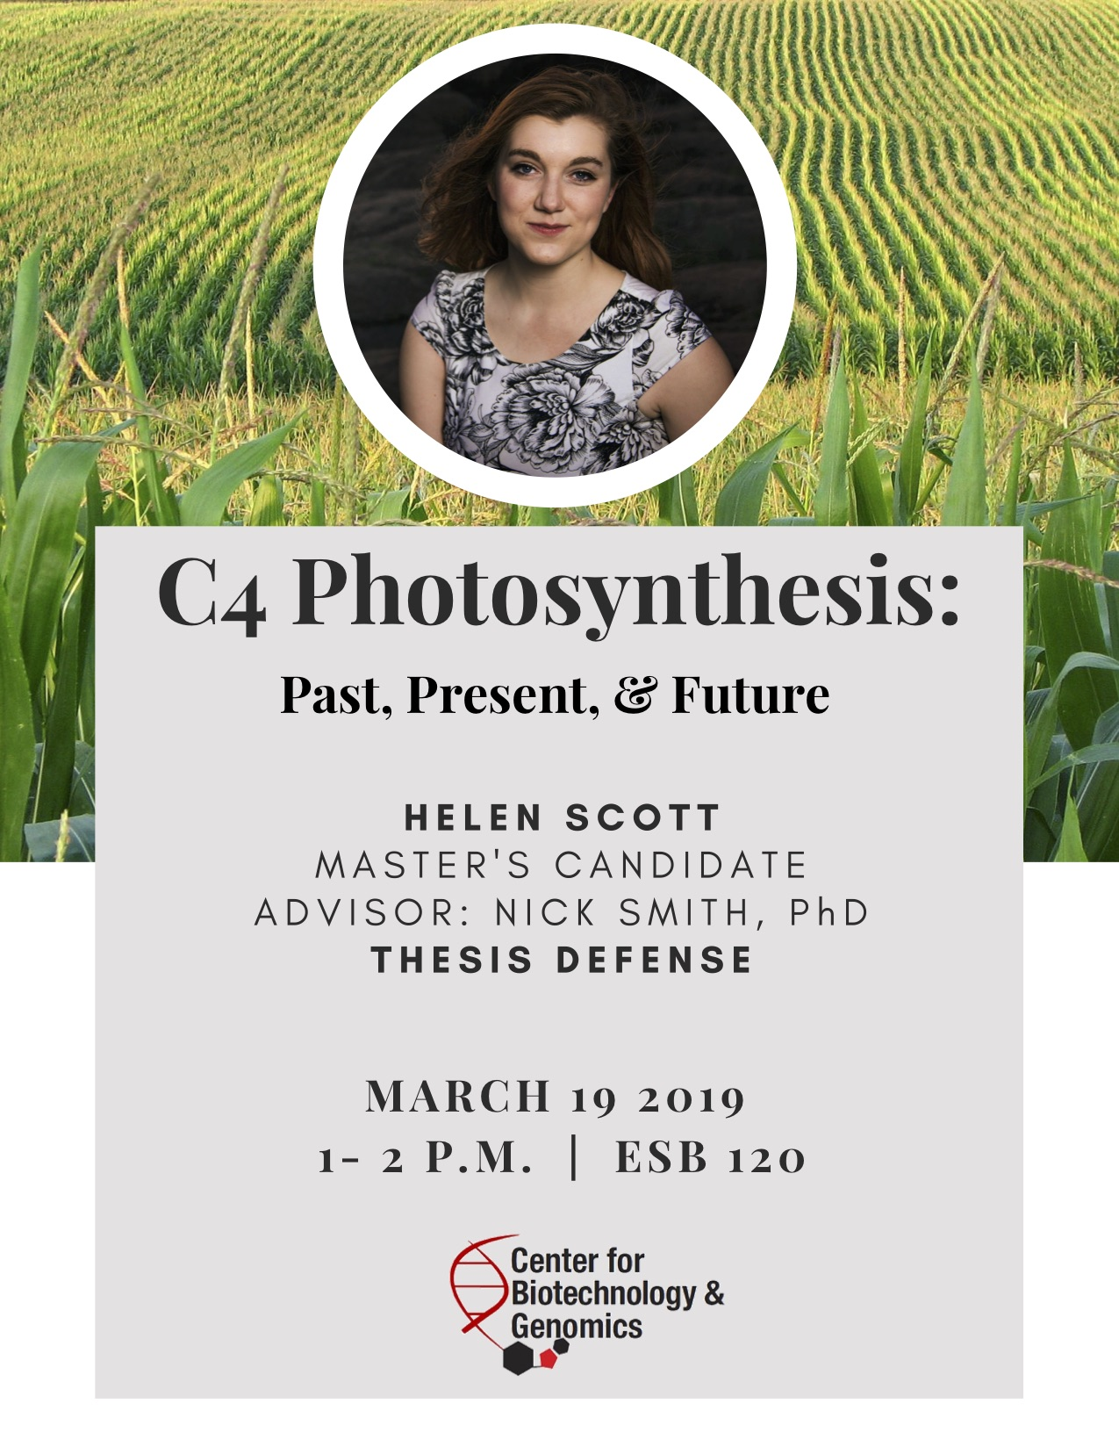
Photosynthetic acclimation through the lens of optimality
Nick Smith
Texas Tech University
nick.smith@ttu.edu; @nick_greg_smith
Lizz Waring
TTU
Helen Scott
TTU
Trevor Keenan
Berkeley Lab
Wang Han
Tsinghua U.
Colin Prentice
Imperial College

Slide 2
Photosynthesis is important!
nick.smith@ttu.edu; @nick_greg_smith

Slide 3
Photosynthesis is important!
nick.smith@ttu.edu; @nick_greg_smith
Data from IPCC (2013)

Slide 4
Photosynthesis is important!
nick.smith@ttu.edu; @nick_greg_smith
Photosynthesis
Data from IPCC (2013)

Slide 5
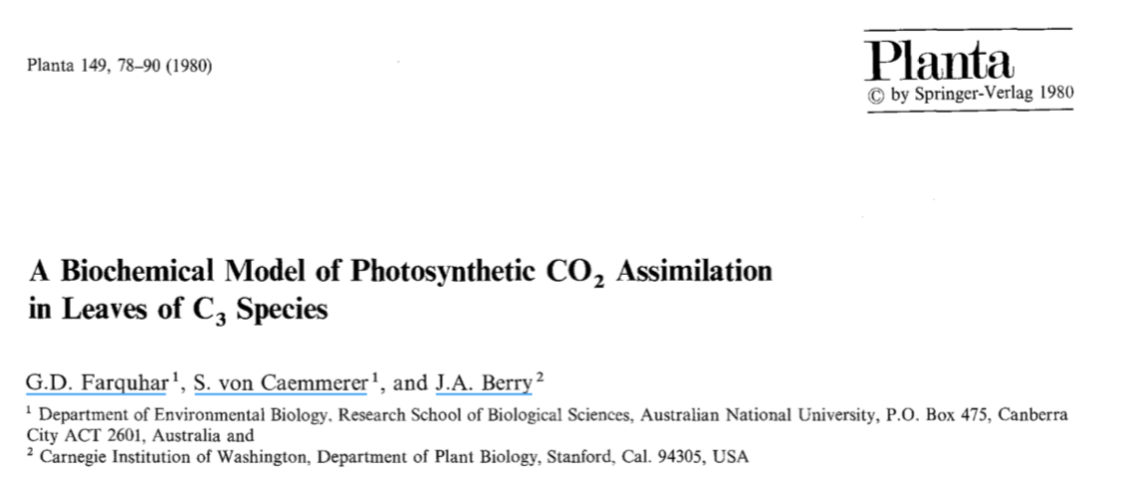
Theoretical models for photosynthesis exist
nick.smith@ttu.edu; @nick_greg_smith

Slide 6
These produce short term responses that match data
nick.smith@ttu.edu; @nick_greg_smith

Slide 7
Long-term responses can differ from short-term responses due to acclimation
nick.smith@ttu.edu; @nick_greg_smith

Slide 8
Long-term responses can differ from short-term responses due to acclimation
nick.smith@ttu.edu; @nick_greg_smith
Acclimated to high light
Acclimated to low light

Slide 9
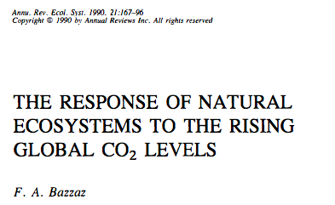
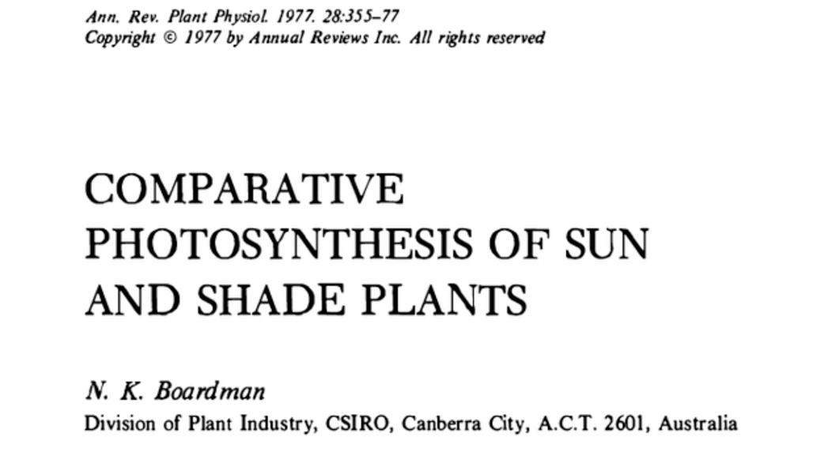
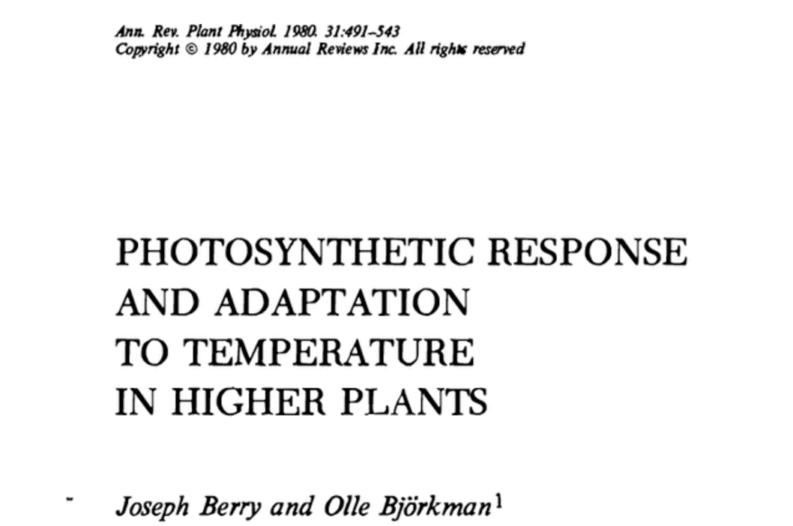
Acclimation is ubiquitous and well known…
nick.smith@ttu.edu; @nick_greg_smith
Temperature: Berry & Björkman (1980)
CO₂: Bazzaz (1990)
Light: Boardman (1977)

Slide 10
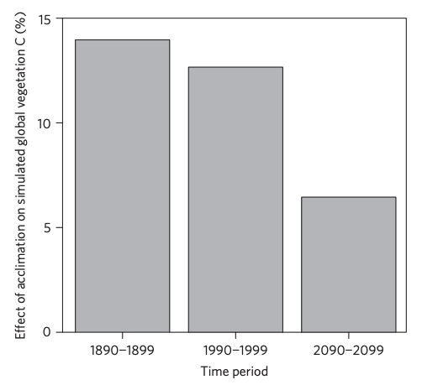
…and can impact carbon cycling and climate
nick.smith@ttu.edu; @nick_greg_smith
Smith et al. (2017) Nature Climate Change
Smith et al. (2017) JAMES

Slide 11
But no theoretical model for photosynthetic acclimation exists
nick.smith@ttu.edu; @nick_greg_smith

Slide 12
Lack of theory results in…
nick.smith@ttu.edu; @nick_greg_smith

Slide 13
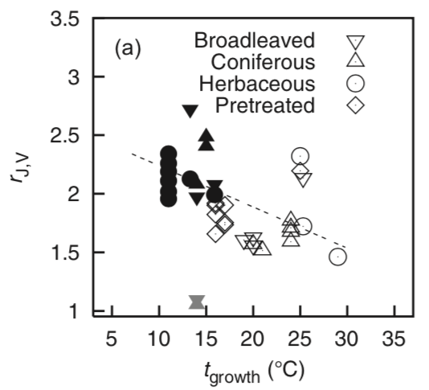
Lack of theory results in…
nick.smith@ttu.edu; @nick_greg_smith
Unreliable future predictions (overparameterization, tuning)
Kattge and Knorr (2007) PC&E
Smith et al. (2017) JAMES

Slide 14
Lack of theory results in…
nick.smith@ttu.edu; @nick_greg_smith
Inability to test mechanisms
Kattge and Knorr (2007) PC&E
Smith et al. (2017) JAMES

Slide 15
Our Goal: Develop a mechanistic model of photosynthetic acclimation based on optimization and the first principles of plant physiological theory
nick.smith@ttu.edu; @nick_greg_smith

Slide 16
Optimization: Least cost hypothesis
nick.smith@ttu.edu; @nick_greg_smith
Maintain fastest rate of photosynthesis at the lowest cost (water and nutrient use)
Wright et al. (2003) American Naturalist

Slide 17
Optimal photosynthesis
nick.smith@ttu.edu; @nick_greg_smith
Photosynthesis = f{stomatal conductance,
photosynthetic biochemistry}

Slide 18
Optimal photosynthesis
nick.smith@ttu.edu; @nick_greg_smith
Photosynthesis = f{stomatal conductance,
photosynthetic biochemistry}
Must predict optimal rates of both

Slide 19
Optimal photosynthesis
nick.smith@ttu.edu; @nick_greg_smith
Photosynthesis = f{stomatal conductance,
photosynthetic biochemistry}

Slide 20
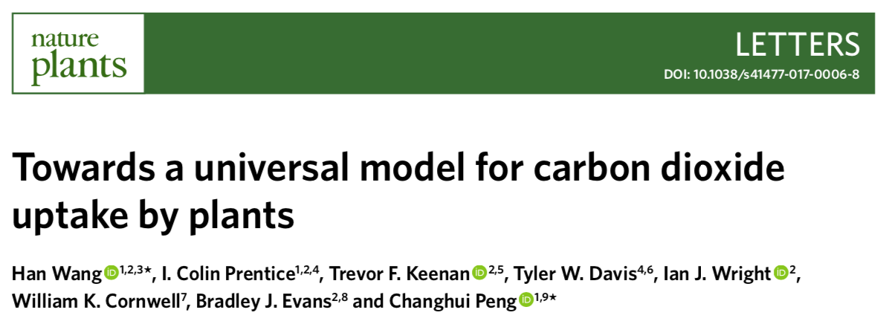
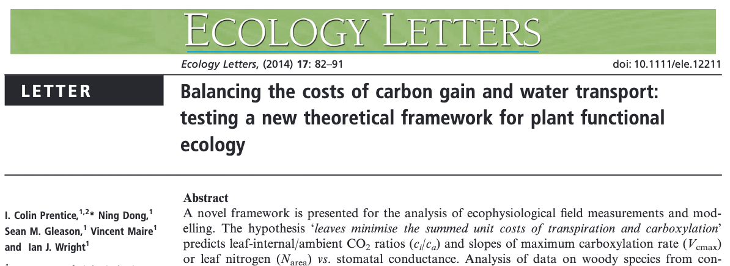

Slide 21
Optimal photosynthesis
Photosynthesis = f{stomatal conductance,
photosynthetic biochemistry}

Slide 22
Biochemistry optimization: Coordination hypothesis
Photosynthesis may be limited by Rubisco carboxylation rate or electron transport rate to regenerate Rubisco

Slide 23
Biochemistry optimization: Coordination hypothesis
Photosynthesis may be limited by Rubisco carboxylation rate or electron transport rate to regenerate Rubisco
Optimally, plants will coordinate their biochemistry to be equally limited by both rates

Slide 24
Coordination of photosynthesis
nick.smith@ttu.edu; @nick_greg_smith
Optimally…
A_{c} = A_{j}
Electron transport-limited photosynthesis
Carboxylation-limited photosynthesis

Slide 25
Coordination of photosynthesis
nick.smith@ttu.edu; @nick_greg_smith
A_{c} = f {V_{cmax}, T, c_{i}}
A_{j} = f {light, T, c_{i}}
Carboxylation-limited photosynthesis
Electron transport-limited photosynthesis
Farquhar, von Caemmer, & Berry (1980) Planta

Slide 26
Rearrange to solve for measurable traits
nick.smith@ttu.edu; @nick_greg_smith
V_{cmax} = f {light, T, c_{i}}
Smith et al. (2019) Ecology Letters

Slide 27
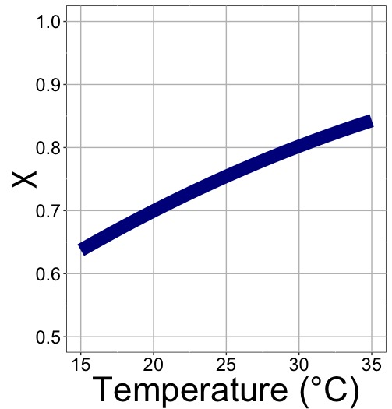
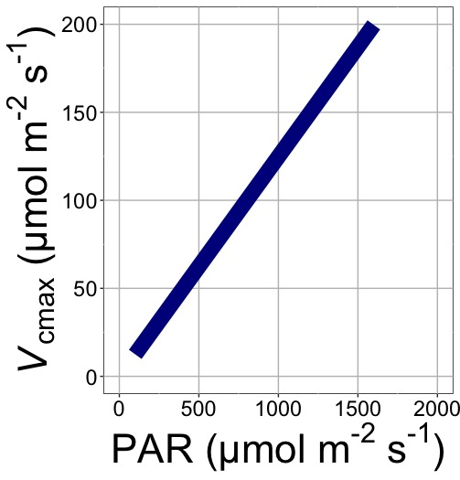
nick.smith@ttu.edu; @nick_greg_smith
V_{cmax} increases with light because of greater electron transport
Smith et al. (2019) Ecology Letters

Slide 28
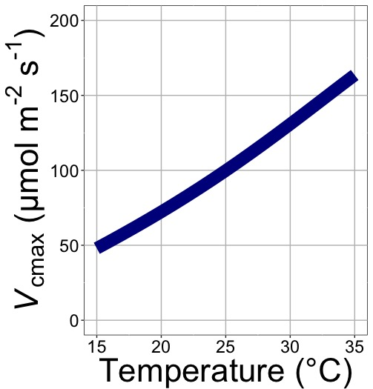
nick.smith@ttu.edu; @nick_greg_smith
V_{cmax} increases with temperature because of greater electron transport and photorespiration
Smith et al. (2019) Ecology Letters

Slide 29
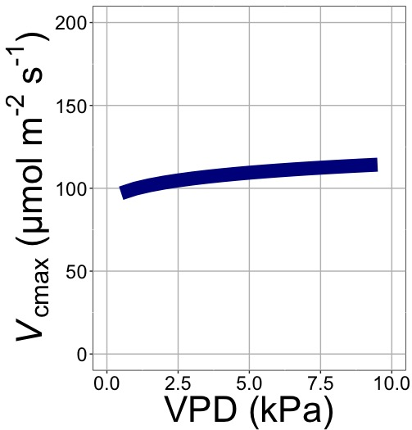
nick.smith@ttu.edu; @nick_greg_smith
V_{cmax} increases with VPD because of lower stomatal conductance
Smith et al. (2019) Ecology Letters

Slide 30
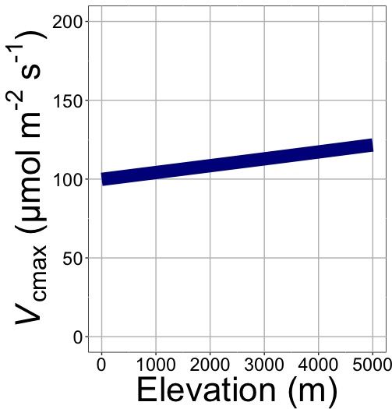
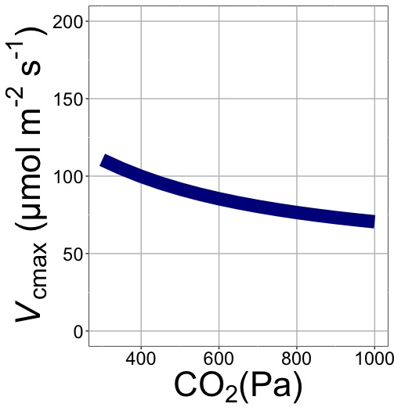
nick.smith@ttu.edu; @nick_greg_smith
V_{cmax} decreases with CO₂ because of lower c_{i}
Smith et al. (2019) Ecology Letters

Slide 31
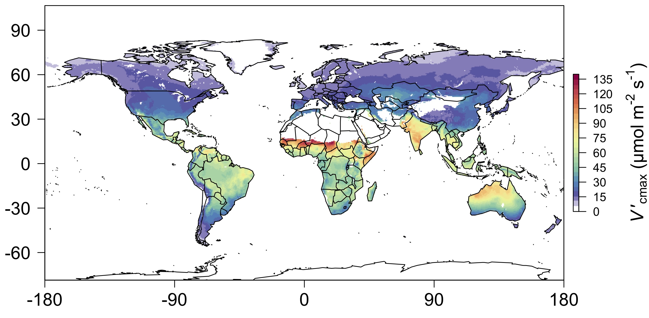
nick.smith@ttu.edu; @nick_greg_smith
We can predict optimal V_{cmax}
Smith et al. (2019) Ecology Letters

Slide 32
Ok, great, but now what?
nick.smith@ttu.edu; @nick_greg_smith

Slide 33
Let’s tackle some big questions in plant ecophysiology!
nick.smith@ttu.edu; @nick_greg_smith

Slide 34
Question 1: Is photosynthesis optimized to the environment?
nick.smith@ttu.edu; @nick_greg_smith

Slide 35
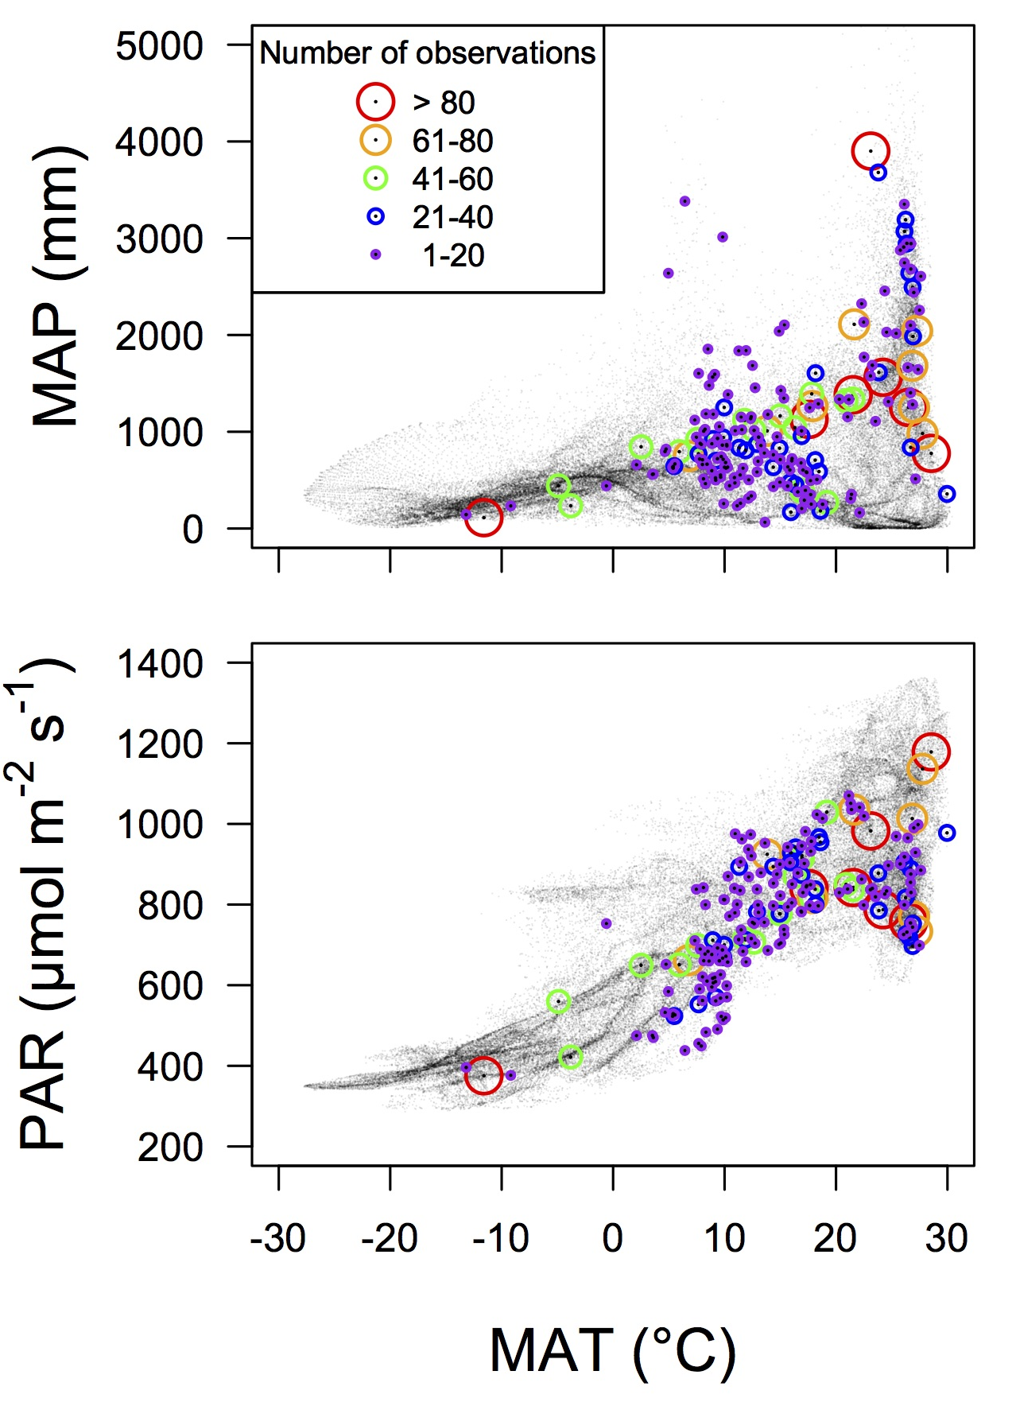
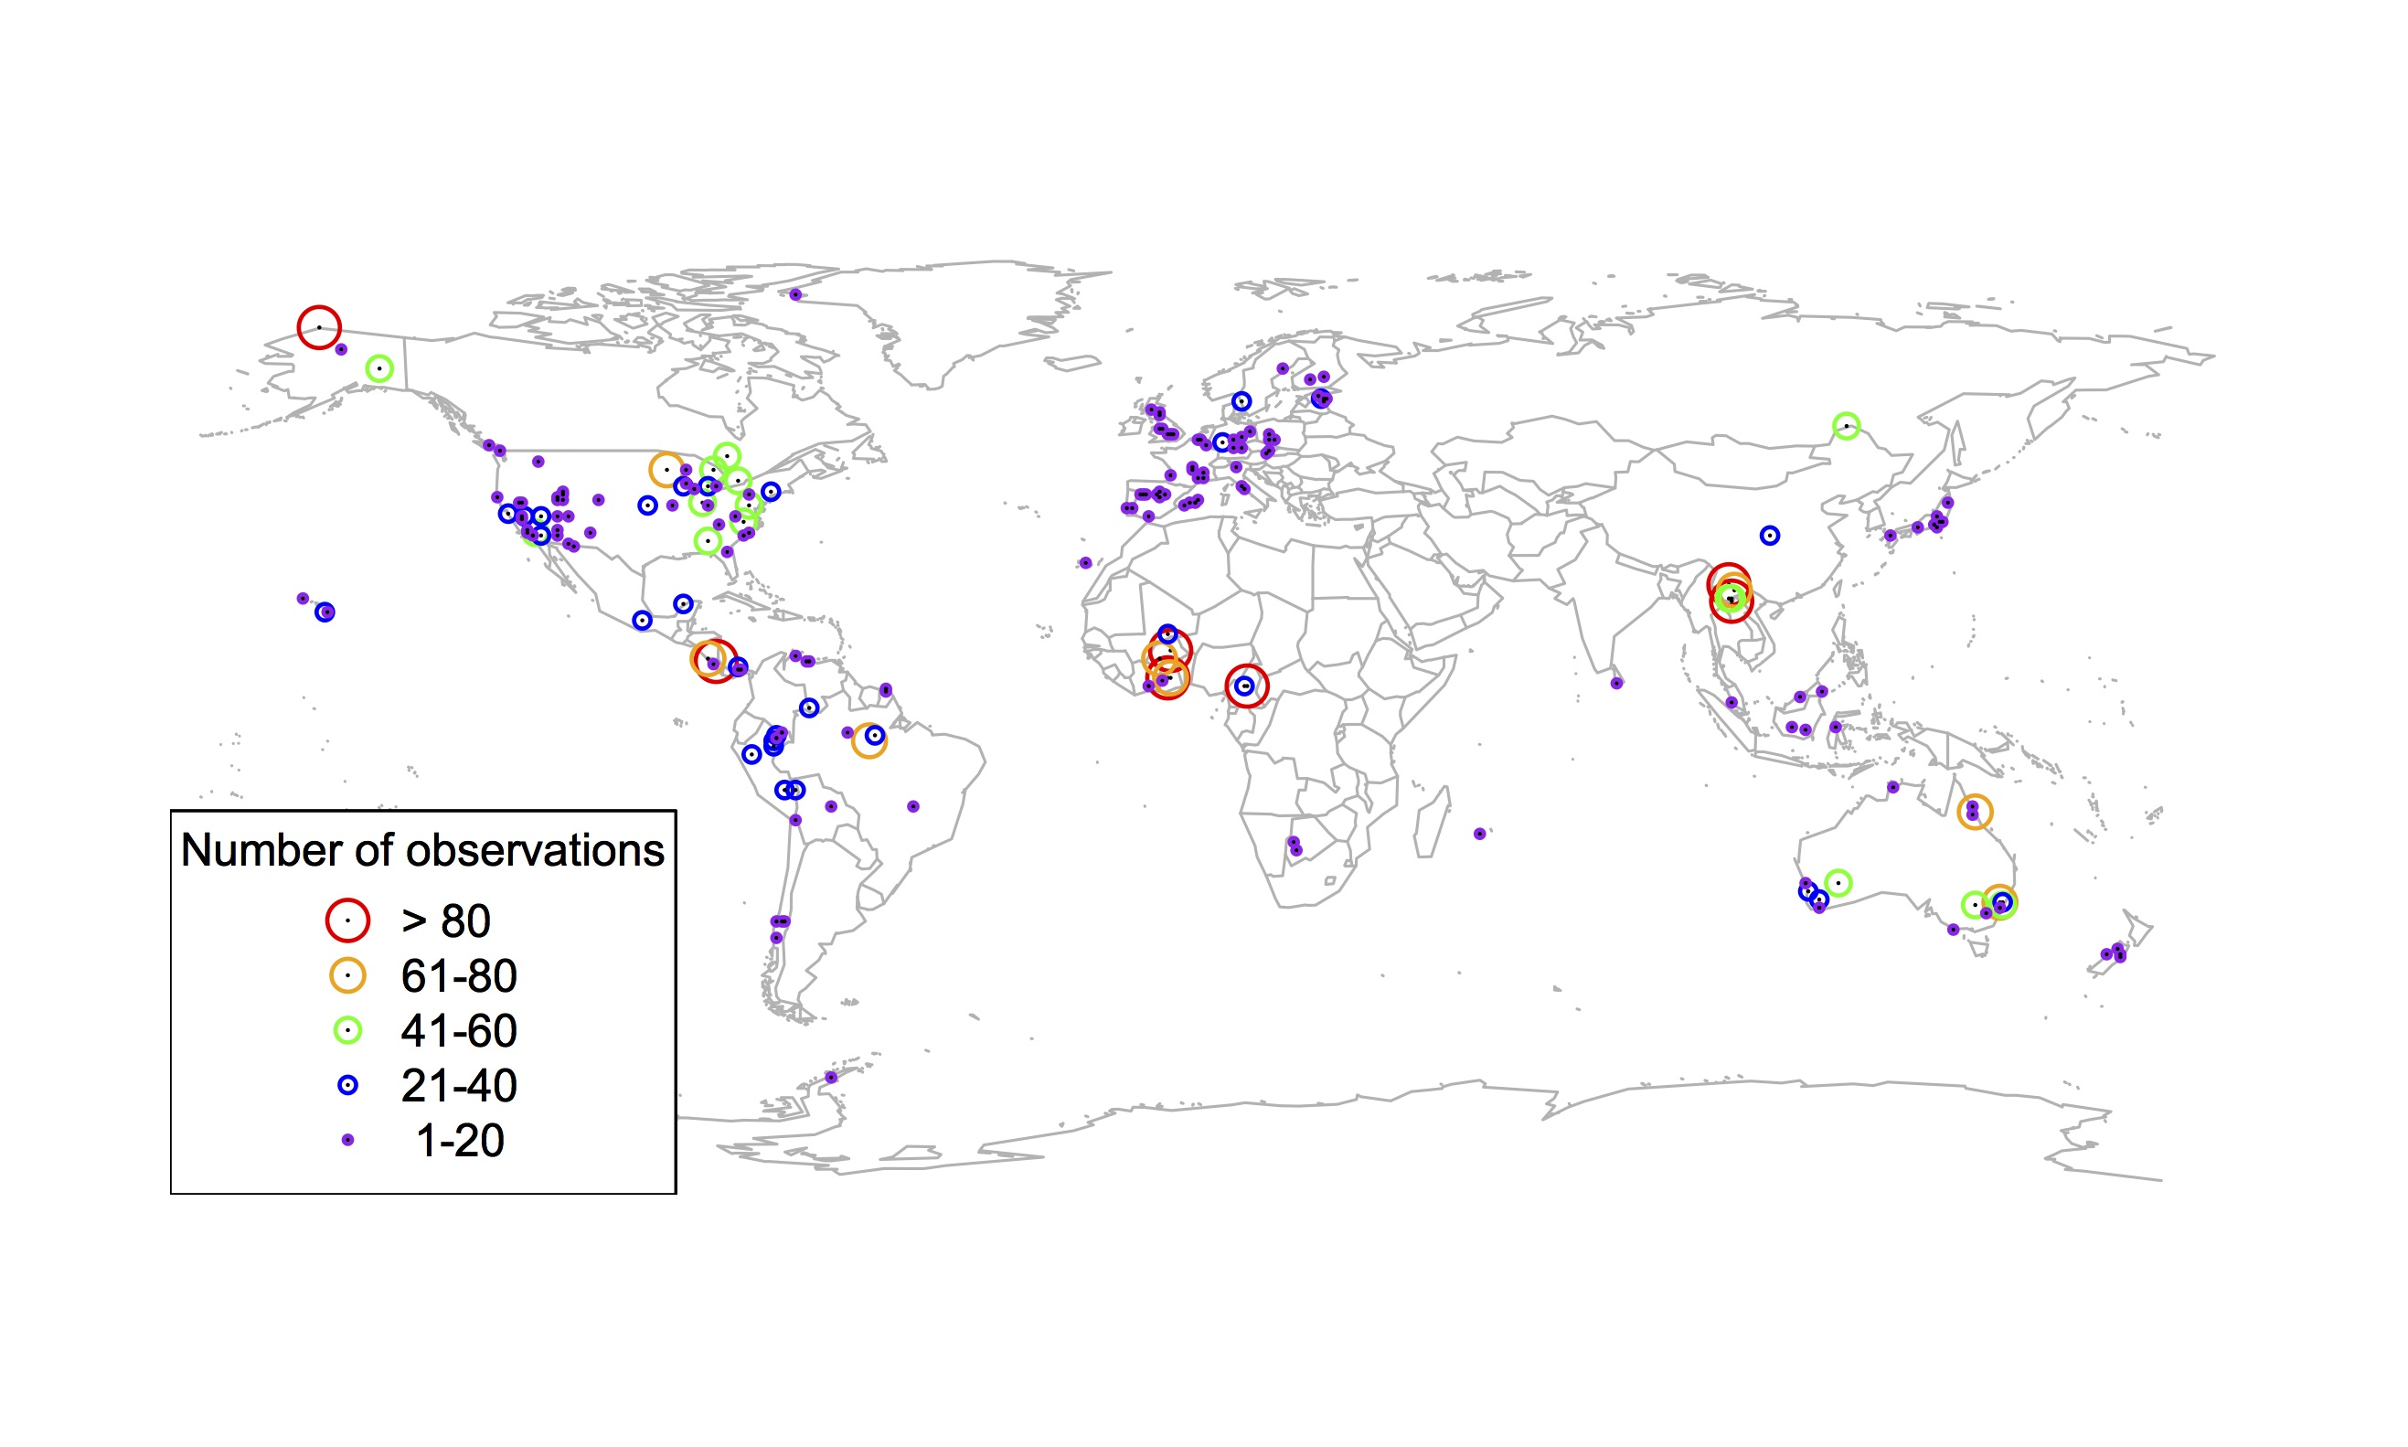
Global V_{cmax} dataset
nick.smith@ttu.edu; @nick_greg_smith
3,697 measurements
202 sites
> 600 genera
Smith et al. (2019) Ecology Letters

Slide 36

nick.smith@ttu.edu; @nick_greg_smith
Smith et al. (2019) Ecology Letters

Slide 37
Question 1: Is photosynthesis optimized to the environment? YES! Photosynthesis acclimates spatially as expected from optimization
nick.smith@ttu.edu; @nick_greg_smith

Slide 38
Question 2: How will photosynthesis acclimate to future conditions?
nick.smith@ttu.edu; @nick_greg_smith

Slide 39
Photosynthetic traits change with temperature and CO₂ in ways expected from optimization
nick.smith@ttu.edu; @nick_greg_smith
Smith and Keenan (in prep)

Slide 40
Photosynthetic traits change with temperature and CO₂ in ways expected from optimization
nick.smith@ttu.edu; @nick_greg_smith
Fully acclimated response
Smith and Keenan (in prep)

Slide 41
Photosynthetic traits change with temperature and CO₂ in ways expected from optimization
nick.smith@ttu.edu; @nick_greg_smith
mean: -12%
mean: -15%
(P > 0.05)
Smith and Keenan (in prep)

Slide 42
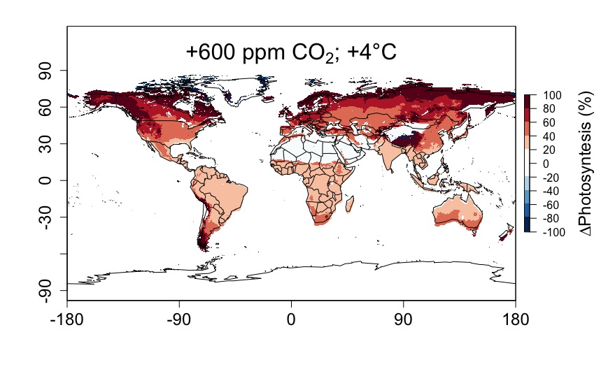
Higher CO₂ and increased temperatures increase future photosynthesis
nick.smith@ttu.edu; @nick_greg_smith
Smith and Keenan (in prep)

Slide 43
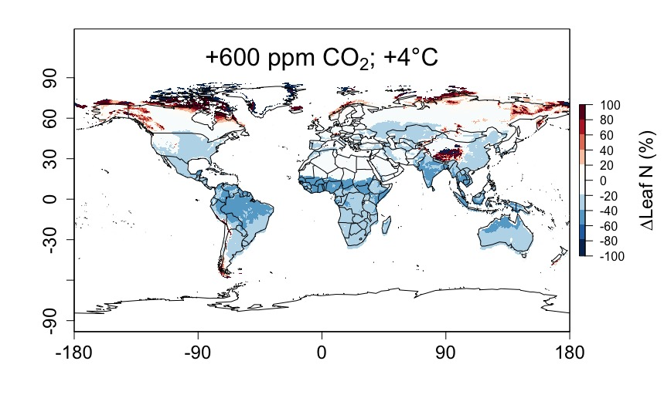
Higher CO₂ and increased temperatures increase future photosynthesis (at lower nutrient use)
nick.smith@ttu.edu; @nick_greg_smith
Smith and Keenan (in prep)

Slide 44
Question 2: How will photosynthesis acclimate to future conditions? Photosynthesis will increase and per-leaf-area nutrient use will decrease
nick.smith@ttu.edu; @nick_greg_smith

Slide 45
Question 3: Does photosynthesis respond to nutrient addition?
nick.smith@ttu.edu; @nick_greg_smith
Lizz Waring
TTU

Slide 46
From the least cost hypothesis…
nick.smith@ttu.edu; @nick_greg_smith
Added nutrients will not increase photosynthesis because light limitation will kick in

Slide 47
From the least cost hypothesis…
nick.smith@ttu.edu; @nick_greg_smith
Added nutrients will not increase photosynthesis because light limitation will kick in
Optimal response would be to increase leaf area

Slide 48
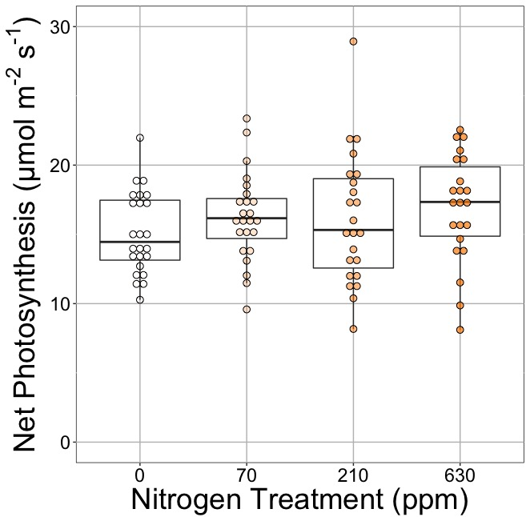
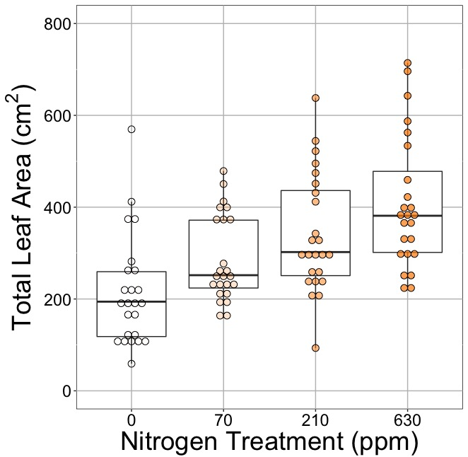
Leaf area, but not photosynthesis increases with N addition
nick.smith@ttu.edu; @nick_greg_smith
Waring and Smith (in prep)

Slide 49
Leaf area, but not photosynthesis increases with N addition
nick.smith@ttu.edu; @nick_greg_smith
Waring and Smith (in prep)

Slide 50
Leaf area, but not photosynthesis increases with N addition
nick.smith@ttu.edu; @nick_greg_smith
Waring and Smith (in prep)

Slide 51
But do greenhouse experiments translate to the field?

Slide 52
Grassland soil nutrient addition network: 27 sites with leaf and whole-plot data

Slide 53
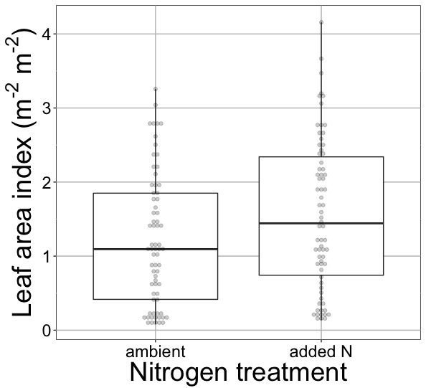
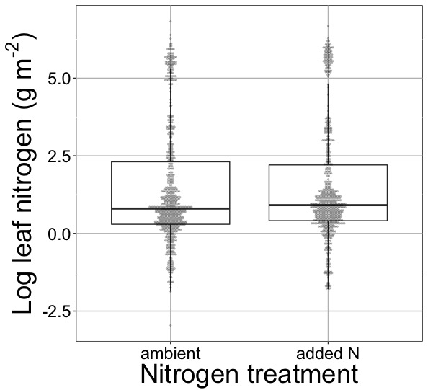
Globally, N addition increases leaf area, not leaf N
nick.smith@ttu.edu; @nick_greg_smith
41% increase (P < 0.05)
No change (P = 0.42)
Waring and Smith (in prep)

Slide 54
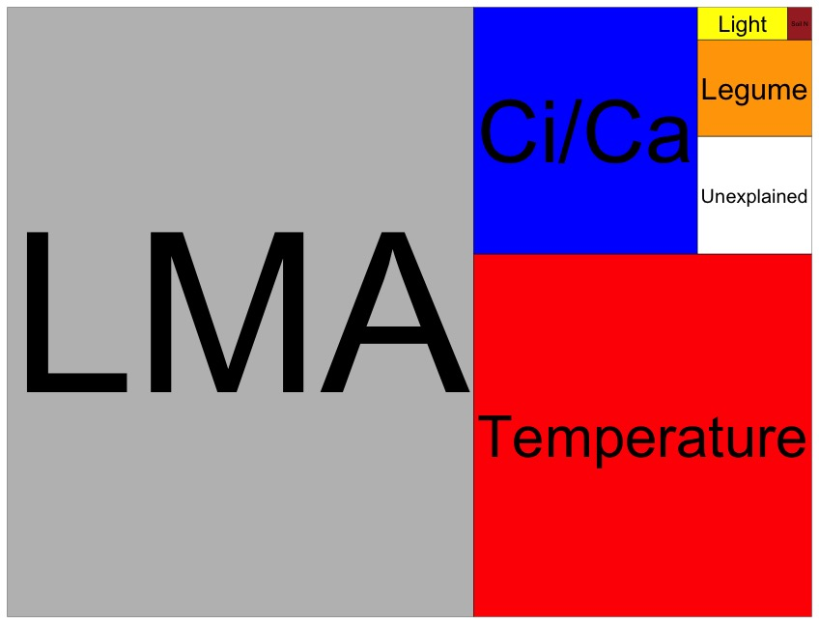
Globally, N addition has no impact on leaf N
nick.smith@ttu.edu; @nick_greg_smith
Each box is proportional to the variance in leaf N explained by each variable
Waring and Smith (in prep)

Slide 55
Question 3: Does photosynthesis respond to nitrogen addition? No, plants respond to added nitrogen by increasing leaf area, not photosynthesis
nick.smith@ttu.edu; @nick_greg_smith

Slide 56
Question 4: When is C₄ photosynthesis an advantage over C₃ photosynthesis?
nick.smith@ttu.edu; @nick_greg_smith
Helen Scott
TTU

Slide 57
C₃ versus C₄ optimization
nick.smith@ttu.edu; @nick_greg_smith

Slide 58
C₄ versus C₃ optimization
nick.smith@ttu.edu; @nick_greg_smith
C₄ photosynthesis has…
No photorespiration
An additional limitation (PEP carboxylation)

Slide 59
C₄ versus C₃ optimization
nick.smith@ttu.edu; @nick_greg_smith
C₄ photosynthesis has…
No photorespiration
An additional limitation (PEP carboxylation)

Slide 60
nick.smith@ttu.edu; @nick_greg_smith
Red = C₄ Blue = C₃
Scott and Smith (in prep)

Slide 61
Question 4: When is C₄ photosynthesis an advantage over C₃ photosynthesis? C₄ is better in hot, dry, low CO₂ environments
nick.smith@ttu.edu; @nick_greg_smith

Slide 62
Conclusions
We have a theoretical model for photosynthetic acclimation
Few empirical parameters
Mechanistically based

Slide 63
Conclusions
We have a theoretical model for photosynthetic acclimation
Few empirical parameters
Mechanistically based
The theory can be useful!
Improving the reliability of climate models
Acting as a null model for understanding mechanisms

Slide 64
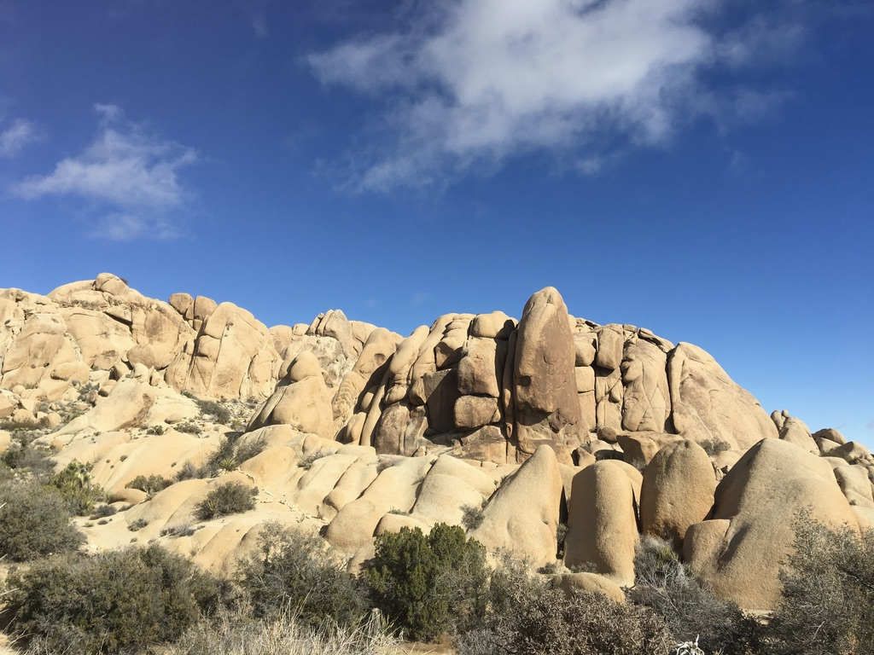
nick.smith@ttu.edu; @nick_greg_smith
Thanks!

Slide 65
nick.smith@ttu.edu; @nick_greg_smith
Open stomata:
Benefits
High CO₂ influx
Costs
High water outflux
Closed stomata:
Benefits
Low water outflux
Costs
Low CO₂ influx

Slide 66
nick.smith@ttu.edu; @nick_greg_smith
Open stomata:
Benefits
High CO₂ influx
Costs
High water outflux
Closed stomata:
Benefits
Low water outflux
Costs
Low CO₂ influx
Must maintain high amount of Rubisco to do photosynthesis

Slide 67
Optimal stomatal conductance
nick.smith@ttu.edu; @nick_greg_smith
Optimal conductance maximizes photosynthesis at least water loss and nutrient use
Water loss is from transpiration
Nutrient use is nutrients used to maintain Rubisco
Rubisco proxy is V_{cmax}

Slide 68
Stomatal openness determines χ
nick.smith@ttu.edu; @nick_greg_smith
χ = internal leaf CO₂ / external leaf CO₂
χ = c_{i} / c_{a}

Slide 69
Optimal χ is a function of the costs and the environment
nick.smith@ttu.edu; @nick_greg_smith
χ = f{temperature,
CO₂,
vapor pressure deficit}
Prentice et al. (2014) Ecology Letters; Wang et al. (2017) Nature Plants

Slide 70
nick.smith@ttu.edu; @nick_greg_smith
χ increases with temperature because of greater photorespiration

Slide 71
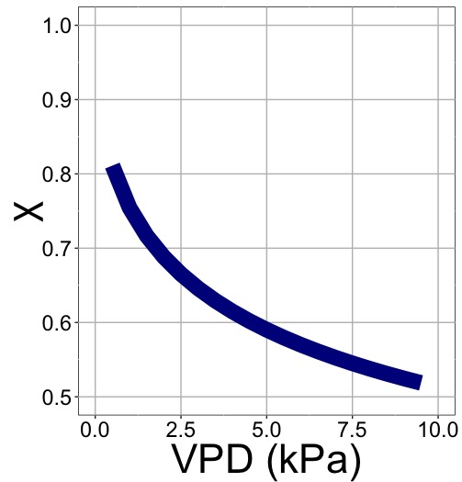
nick.smith@ttu.edu; @nick_greg_smith
χ decreases with VPD because of greater water loss

Slide 72
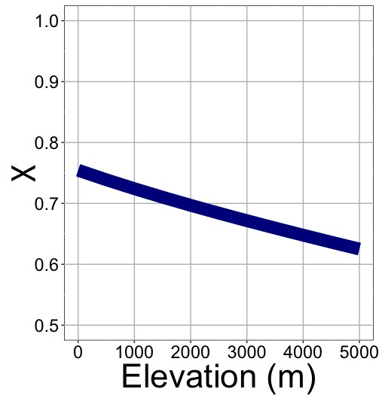
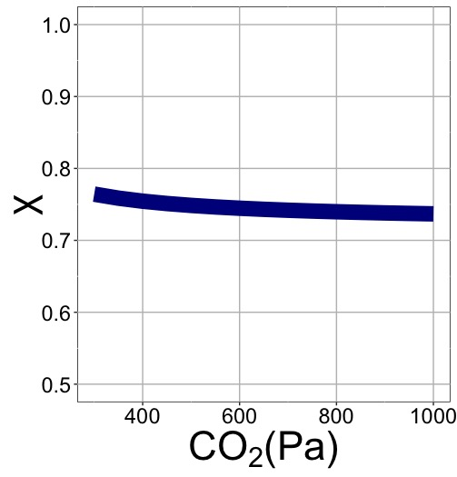
nick.smith@ttu.edu; @nick_greg_smith
χ decreases with elevation because of lower openness needed to satisfy Rubisco

Slide 73
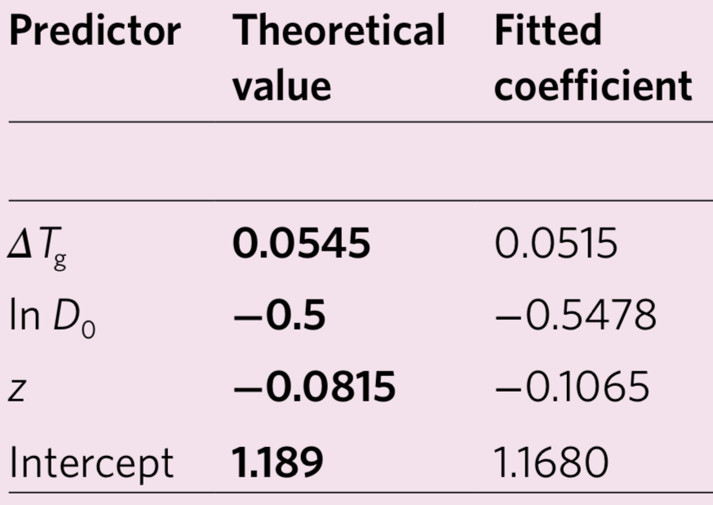
Globally, χ is optimized
nick.smith@ttu.edu; @nick_greg_smith
Wang et al. (2017) Nature Plants

Slide 74
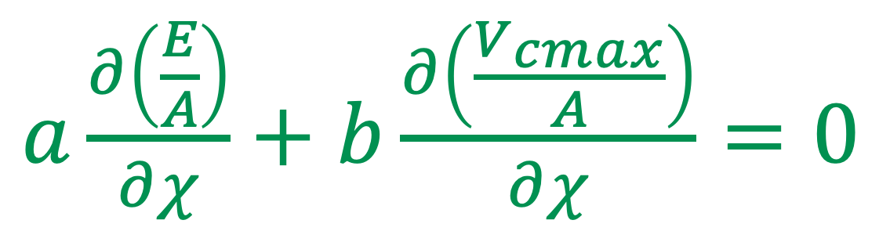
Optimal χ minimizes the costs to maintain transpiration and carboxylation
nick.smith@ttu.edu; @nick_greg_smith
$a\frac{∂\left(\frac{E}{A}\right)}{∂χ}+$ $b\frac{∂\left(\frac{V_{cmax}}{A}\right)}{∂χ}=0$
Cost factor for transpiration (E)
Cost factor for
Rubisco (V_{cmax})
Prentice et al. (2014) Ecology Letters

Slide 75
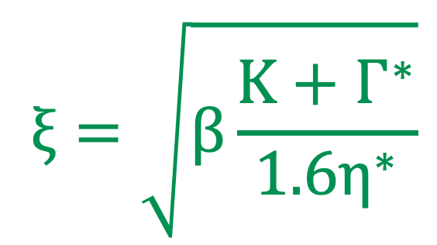
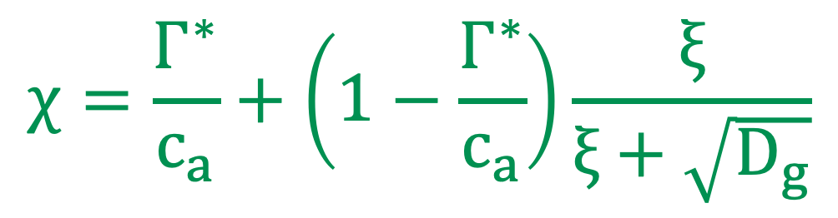
Optimal χ mathmatically
nick.smith@ttu.edu; @nick_greg_smith
$$χ=\frac{Γ^{∗}}{c_{a}}+\left(1−\frac{Γ^{∗}}{c_{a}}\right)\frac{ξ}{ξ+\sqrt{D_{g}}}$$
$$ξ=\sqrt{β\frac{K+Γ^{∗}}{1.6η^{∗}}}$$
Prentice et al. (2014) Ecology Letters

Slide 76
Optimal χ is a function of the costs and the environment
nick.smith@ttu.edu; @nick_greg_smith
χ = f{transpiration cost,
carboxylation cost,
temperature,
CO₂,
vapor pressure deficit}
Empirically derived constants
Prentice et al. (2014) Ecology Letters

Slide 77
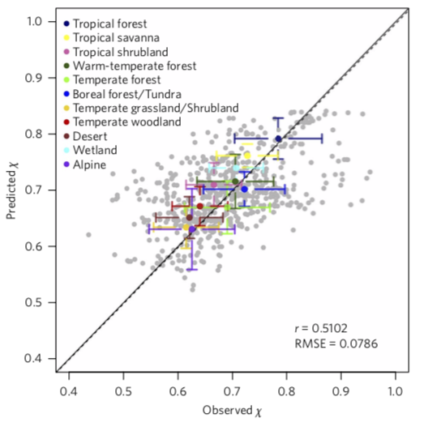
nick.smith@ttu.edu; @nick_greg_smith
b/a = 146
Wang et al. (2017) Nature Plants

Slide 78
Optimal χ is a function of the costs and the environment
nick.smith@ttu.edu; @nick_greg_smith
χ = f{transpiration cost,
carboxylation cost,
temperature,
CO₂,
vapor pressure deficit}
Environmental
variables
Prentice et al. (2014) Ecology Letters

Slide 79
nick.smith@ttu.edu; @nick_greg_smith
But no theoretical model
V_{cmax}: maximum rate of Rubsico carboxylation
Rogers (2012). Photosynthesis Res.

Slide 80
nick.smith@ttu.edu; @nick_greg_smith
But photosynthetic parameters are uncertain
V_{cmax}: maximum rate of Rubsico carboxylation
Rogers (2012). Photosynthesis Res.

Slide 81
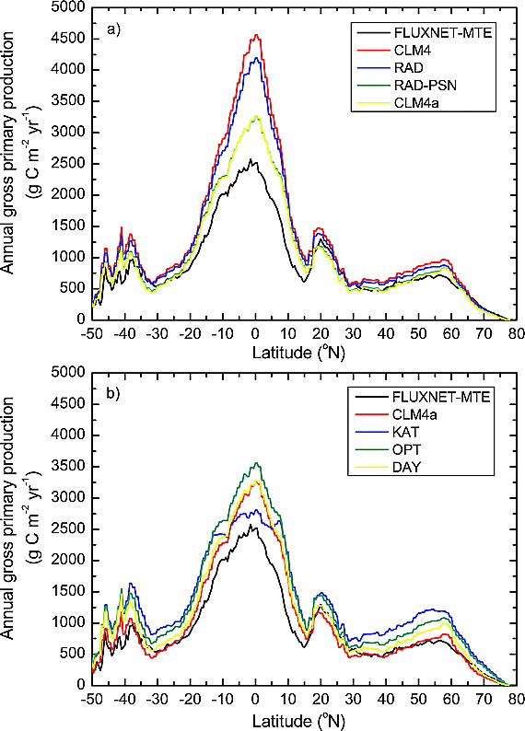
nick.smith@ttu.edu; @nick_greg_smith
Parameter uncertainty alters simulated global carbon uptake – indirectly influencing climate
Bonan et al. (2011). JGR-Biogeosciences.
Notes:
Zonal average annual GPP for (a) model structural error and (b) model parameter uncertainty in comparison with FLUXNET‐MTE. Figure 5a shows model structural error for simulations CLM4, RAD, RAD‐PSN, and CLM4a (RAD‐PSN‐KN). Figure 5b shows model parameter uncertainty for simulations KAT, OPT, and DAY in comparison with CLM4a.
IF THIS IMAGE HAS BEEN PROVIDED BY OR IS OWNED BY A THIRD PARTY, AS INDICATED IN THE CAPTION LINE, THEN FURTHER PERMISSION MAY BE NEEDED BEFORE ANY FURTHER USE. PLEASE CONTACT WILEY'S PERMISSIONS DEPARTMENT ON PERMISSIONS@WILEY.COM OR USE THE RIGHTSLINK SERVICE BY CLICKING ON THE 'REQUEST PERMISSIONS' LINK ACCOMPANYING THIS ARTICLE. WILEY OR AUTHOR OWNED IMAGES MAY BE USED FOR NON-COMMERCIAL PURPOSES, SUBJECT TO PROPER CITATION OF THE ARTICLE, AUTHOR, AND PUBLISHER.

Slide 82
Parameter uncertainty also directly influences climate through energy fluxes
nick.smith@ttu.edu; @nick_greg_smith
Higher photosynthesis
Shifts in global temps
Smith et al. (2017) JAMES
Notes:
Here I will walk you through the effects step by step. First, we found that acclimation increased future photosynthesis

Slide 83
Predicting photosynthesis is important! (and not trivial)
nick.smith@ttu.edu; @nick_greg_smith

Slide 84
What we know well: Short-term responses of photosynthesis
nick.smith@ttu.edu; @nick_greg_smith

Slide 85
What we know well: Short-term responses of photosynthesis
nick.smith@ttu.edu; @nick_greg_smith
Models reproduce these curves very well!

Slide 86
…but can we reliably model it?
nick.smith@ttu.edu; @nick_greg_smith

Slide 87
Modeling acclimation: the typical approach
nick.smith@ttu.edu; @nick_greg_smith
Measure plants following acclimation
Measure the change in response parameters to changes in conditions
Kattge and Knorr (2007) PC&E & many other studies (including my own)

Slide 88
Modeling acclimation: the typical approach
nick.smith@ttu.edu; @nick_greg_smith
Measure plants following acclimation
Measure the change in response parameters to changes in conditions
Problems:
Leads to over-parameterization
Confounds multiple effects
Tuned to limited measurements
Not mechanistic

Slide 89
Our Approach: Step back and simplify
nick.smith@ttu.edu; @nick_greg_smith

Slide 90
Our approach
nick.smith@ttu.edu; @nick_greg_smith
Goal
Predict acclimation responses without reliance on empirical parameters
Toolbox
Photosynthetic theory
Assumption
Given enough time, plants will acclimate to photosynthesize at the

Slide 91
nick.smith@ttu.edu; @nick_greg_smith
χ decreases with elevation because of greater VPD

Slide 92
nick.smith@ttu.edu; @nick_greg_smith
V_{cmax} increases with elevation because of lower stomatal conductance
Smith et al. (2019) Ecology Letters

